Slide 1
Lecture 7: Spatio-temporal models
May 8, 2018
Notes:
namespace density functions
consolidate spatial smoothers into smaller blocks of code
[ ] email Jim about new project idea

Slide 2
Multiple ways to include interactions
Arises for whenever there’s multiple factors
Include spatial effect (No / Yes)
Include temporal effect (No / Independent / Smoothed)
Include spatio-temporal effect (No / Independent / Smoothed)
Notes:
Marginal effects of space and time

Slide 3
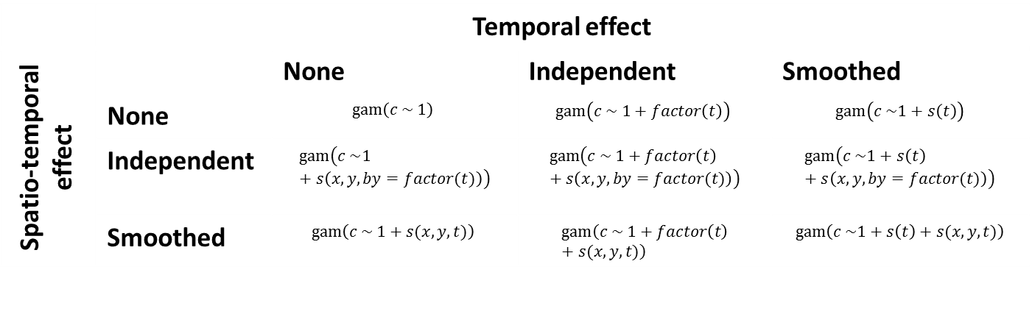
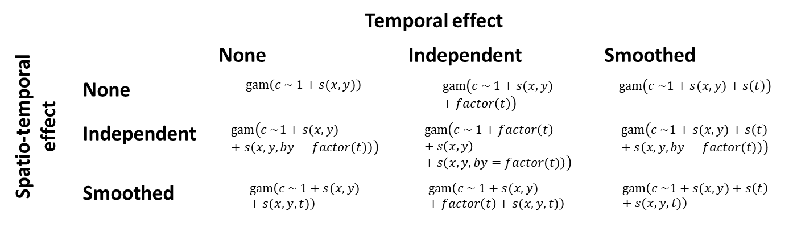
Without spatial
With spatial
 | Temporal effect
Spatio-temporal effect |  | None | Independent | Smoothed
 | None | $$gam\left(c \sim 1\right)$$ | $$gam\left(c \sim 1+factor\left(t\right)\right)$$ | $$gam\left(c \sim 1+s\left(t\right)\right)$$
 | Independent | $$gam\left(c \sim 1+s\left(x, y,by=factor(t)\right)\right)$$ | $$gam\left(c \sim 1+factor\left(t\right)+s\left(x, y,by=factor(t)\right)\right)$$ | $$gam\left(c \sim 1+s\left(t\right)+s\left(x, y,by=factor(t)\right)\right)$$
 | Smoothed | $$gam\left(c \sim 1+s(x,y,t)\right)$$ | $$gam\left(c \sim 1+factor\left(t\right)+s(x,y,t)\right)$$ | $$gam\left(c \sim 1+s\left(t\right)+s(x,y,t)\right)$$
 | Temporal effect
Spatio-temporal effect |  | None | Independent | Smoothed
 | None | $$gam\left(c \sim 1+s(x,y)\right)$$ | $$gam\left(c \sim 1+s(x,y)+factor\left(t\right)\right)$$ | $$gam\left(c \sim 1+s(x,y)+s\left(t\right)\right)$$
 | Independent | $$gam\left(c \sim 1+s(x,y)+s\left(x, y,by=factor(t)\right)\right)$$ | $$gam\left(c \sim 1+factor\left(t\right)+s\left(x,y\right)+s\left(x, y,by=factor(t)\right)\right)$$ | $$gam\left(c \sim 1+s(x,y)+s\left(t\right)+s\left(x, y,by=factor(t)\right)\right)$$
 | Smoothed | $$gam\left(c \sim 1+s(x,y)+s(x,y,t)\right)$$ | $$gam\left(c \sim 1+s(x,y)+factor\left(t\right)+s(x,y,t)\right)$$ | $$gam\left(c \sim 1+s(x,y)+s\left(t\right)+s(x,y,t)\right)$$
Notes:
Notation from mgcv package
Lots of different ways, even without getting into the nonlinear world
s(t) is a smoother or spline, versus treating t as a factor
Mcgv can also deal with isotropic or anisotropic smoothers
Is decorrelation rate constant across dimensions?
May be important to let it vary because time and space wouldn’t make sense together in units
More complicated—tensor spline, which has geometric anisotropy—estimate a separate decorrelation distance for every dimension
Blue box is what Jim calls a spatio-temporal index standardization, has marginal effects of space and time along with interaction
But he uses the one below as a temporal interpolation model
In contrast top model (see publication in 2014 where they propose that) doesn’t allow for distribution shift because there’s no space-time aspect (estimated effect in year will always be a shift up or down)

Slide 4
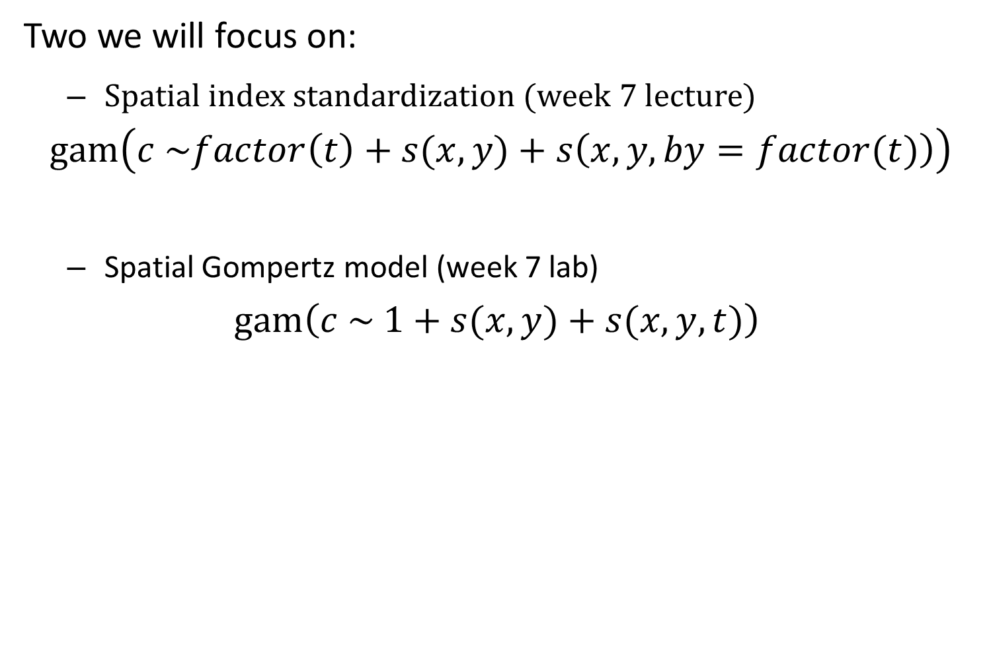
Two we will focus on:
Spatial index standardization (week 7 lecture)
$$gam\left(c \sim factor\left(t\right)+s(x,y)+s\left(x, y,by=factor(t)\right)\right)$$
Spatial Gompertz model (week 7 lab)
$$gam\left(c \sim 1+s(x,y)+s(x,y,t)\right)$$

Slide 5
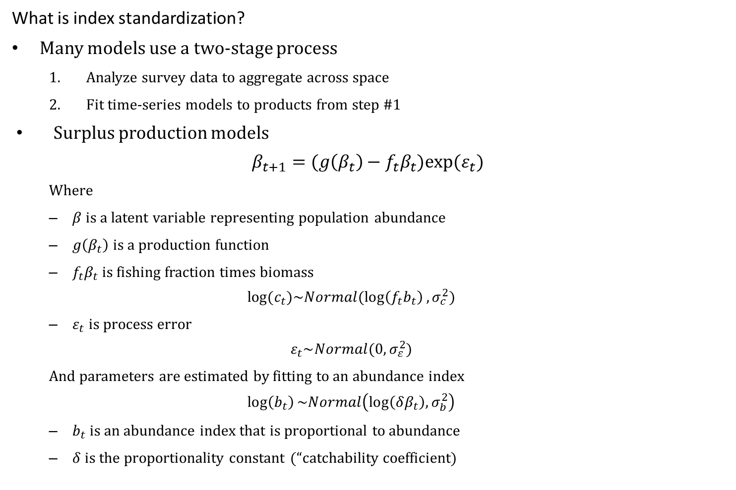
What is index standardization?
Many models use a two-stage process
Analyze survey data to aggregate across space
Fit time-series models to products from step #1
Surplus production models
$$β_{t+1}=(g\left(β_{t}\right)−f_{t}β_{t})exp⁡(ε_{t})$$
Where
$β$ is a latent variable representing population abundance
$g\left(β_{t}\right)$ is a production function
$f_{t}β_{t}$ is fishing fraction times biomass
$$log⁡(c_{t})\sim Normal(\log\left(f_{t}b_{t}\right),σ_{c}^{2})$$
$ε_{t}$ is process error
$$ε_{t}\sim Normal(0,σ_{ε}^{2})$$
And parameters are estimated by fitting to an abundance index
$$\log\left(b_{t}\right)\sim Normal\left(\log\left(δβ_{t}\right),σ_{b}^{2}\right)$$
$b_{t}$ is an abundance index that is proportional to abundance
$δ$ is the proportionality constant (“catchability coefficient)
Notes:
A way of generating an annual index by aggregating across space and filtering out other sources of variance (like vessel effects) or to include covariates like hook depth that might change systematically over time, which we can account for to remove bias
Biostatistics expert two-stage model
Epsilon distribution makes it a state space model
“explicit f” version—don’t subtract catch, that’s much less stable
Make sure that errors are independent (sigma_b) so we can use normal distribution instead of MVN
Likewise, move to do that for catch because they’re highly autocorrelated due to historical issues—need to remove autocorrelation in catch etc.

Slide 6
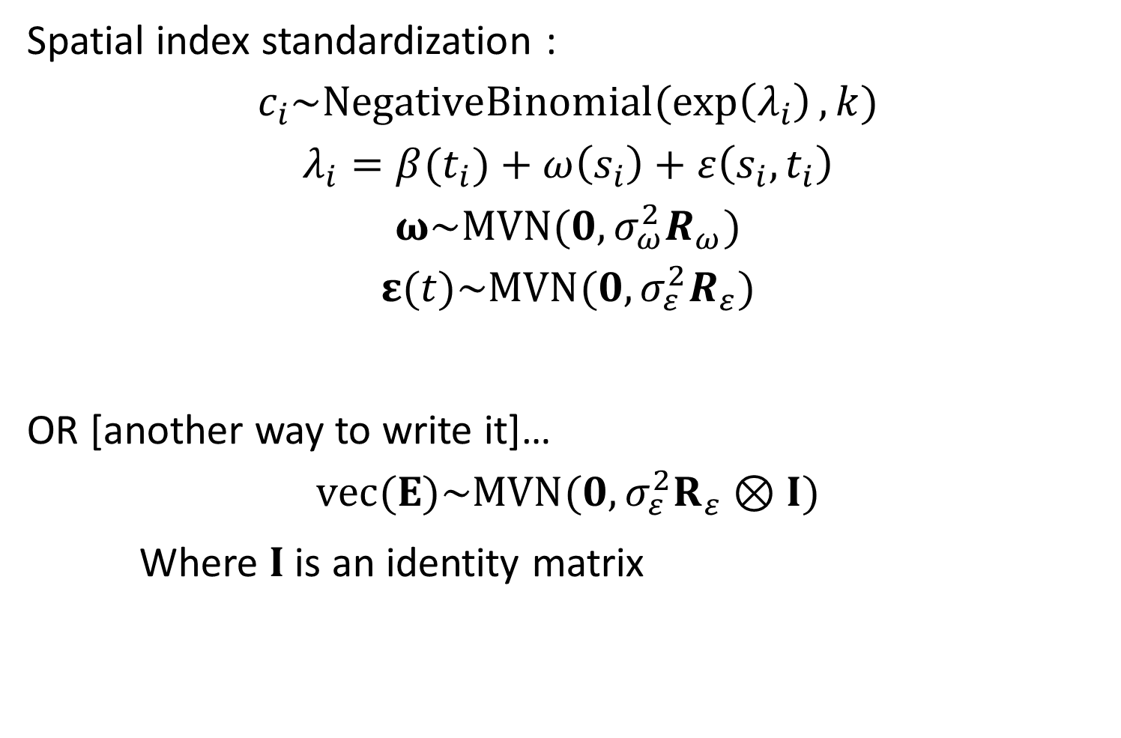
Spatial index standardization :
$$c_{i}\sim NegativeBinomial(\exp\left(λ_{i}\right),k)$$
$$λ_{i}=β(t_{i})+ω\left(s_{i}\right)+ε\left(s_{i},t_{i}\right)$$
$$ω\sim MVN(0,σ_{ω}^{2}R_{ω})$$
$$ε(t)\sim MVN(0,σ_{ε}^{2}R_{ε})$$
OR [another way to write it]…
$$vec(Ε)\sim MVN(0,σ_{ε}^{2}R_{ε}⊗I)$$
Where $I$ is an identity matrix
Notes:
T_i is an intercept
Vector of spatial temporal effect (epsilon(t)) over years is that kroneker product
Dimension of vec(E) is number of sites times number of year
Kroneker product = outer product of two correlation matrices, where one of them is I and the other R is the spatial correlations
Sigma_epsilon is the variance across time and space (scaling, the magnitude of variability)

Slide 7
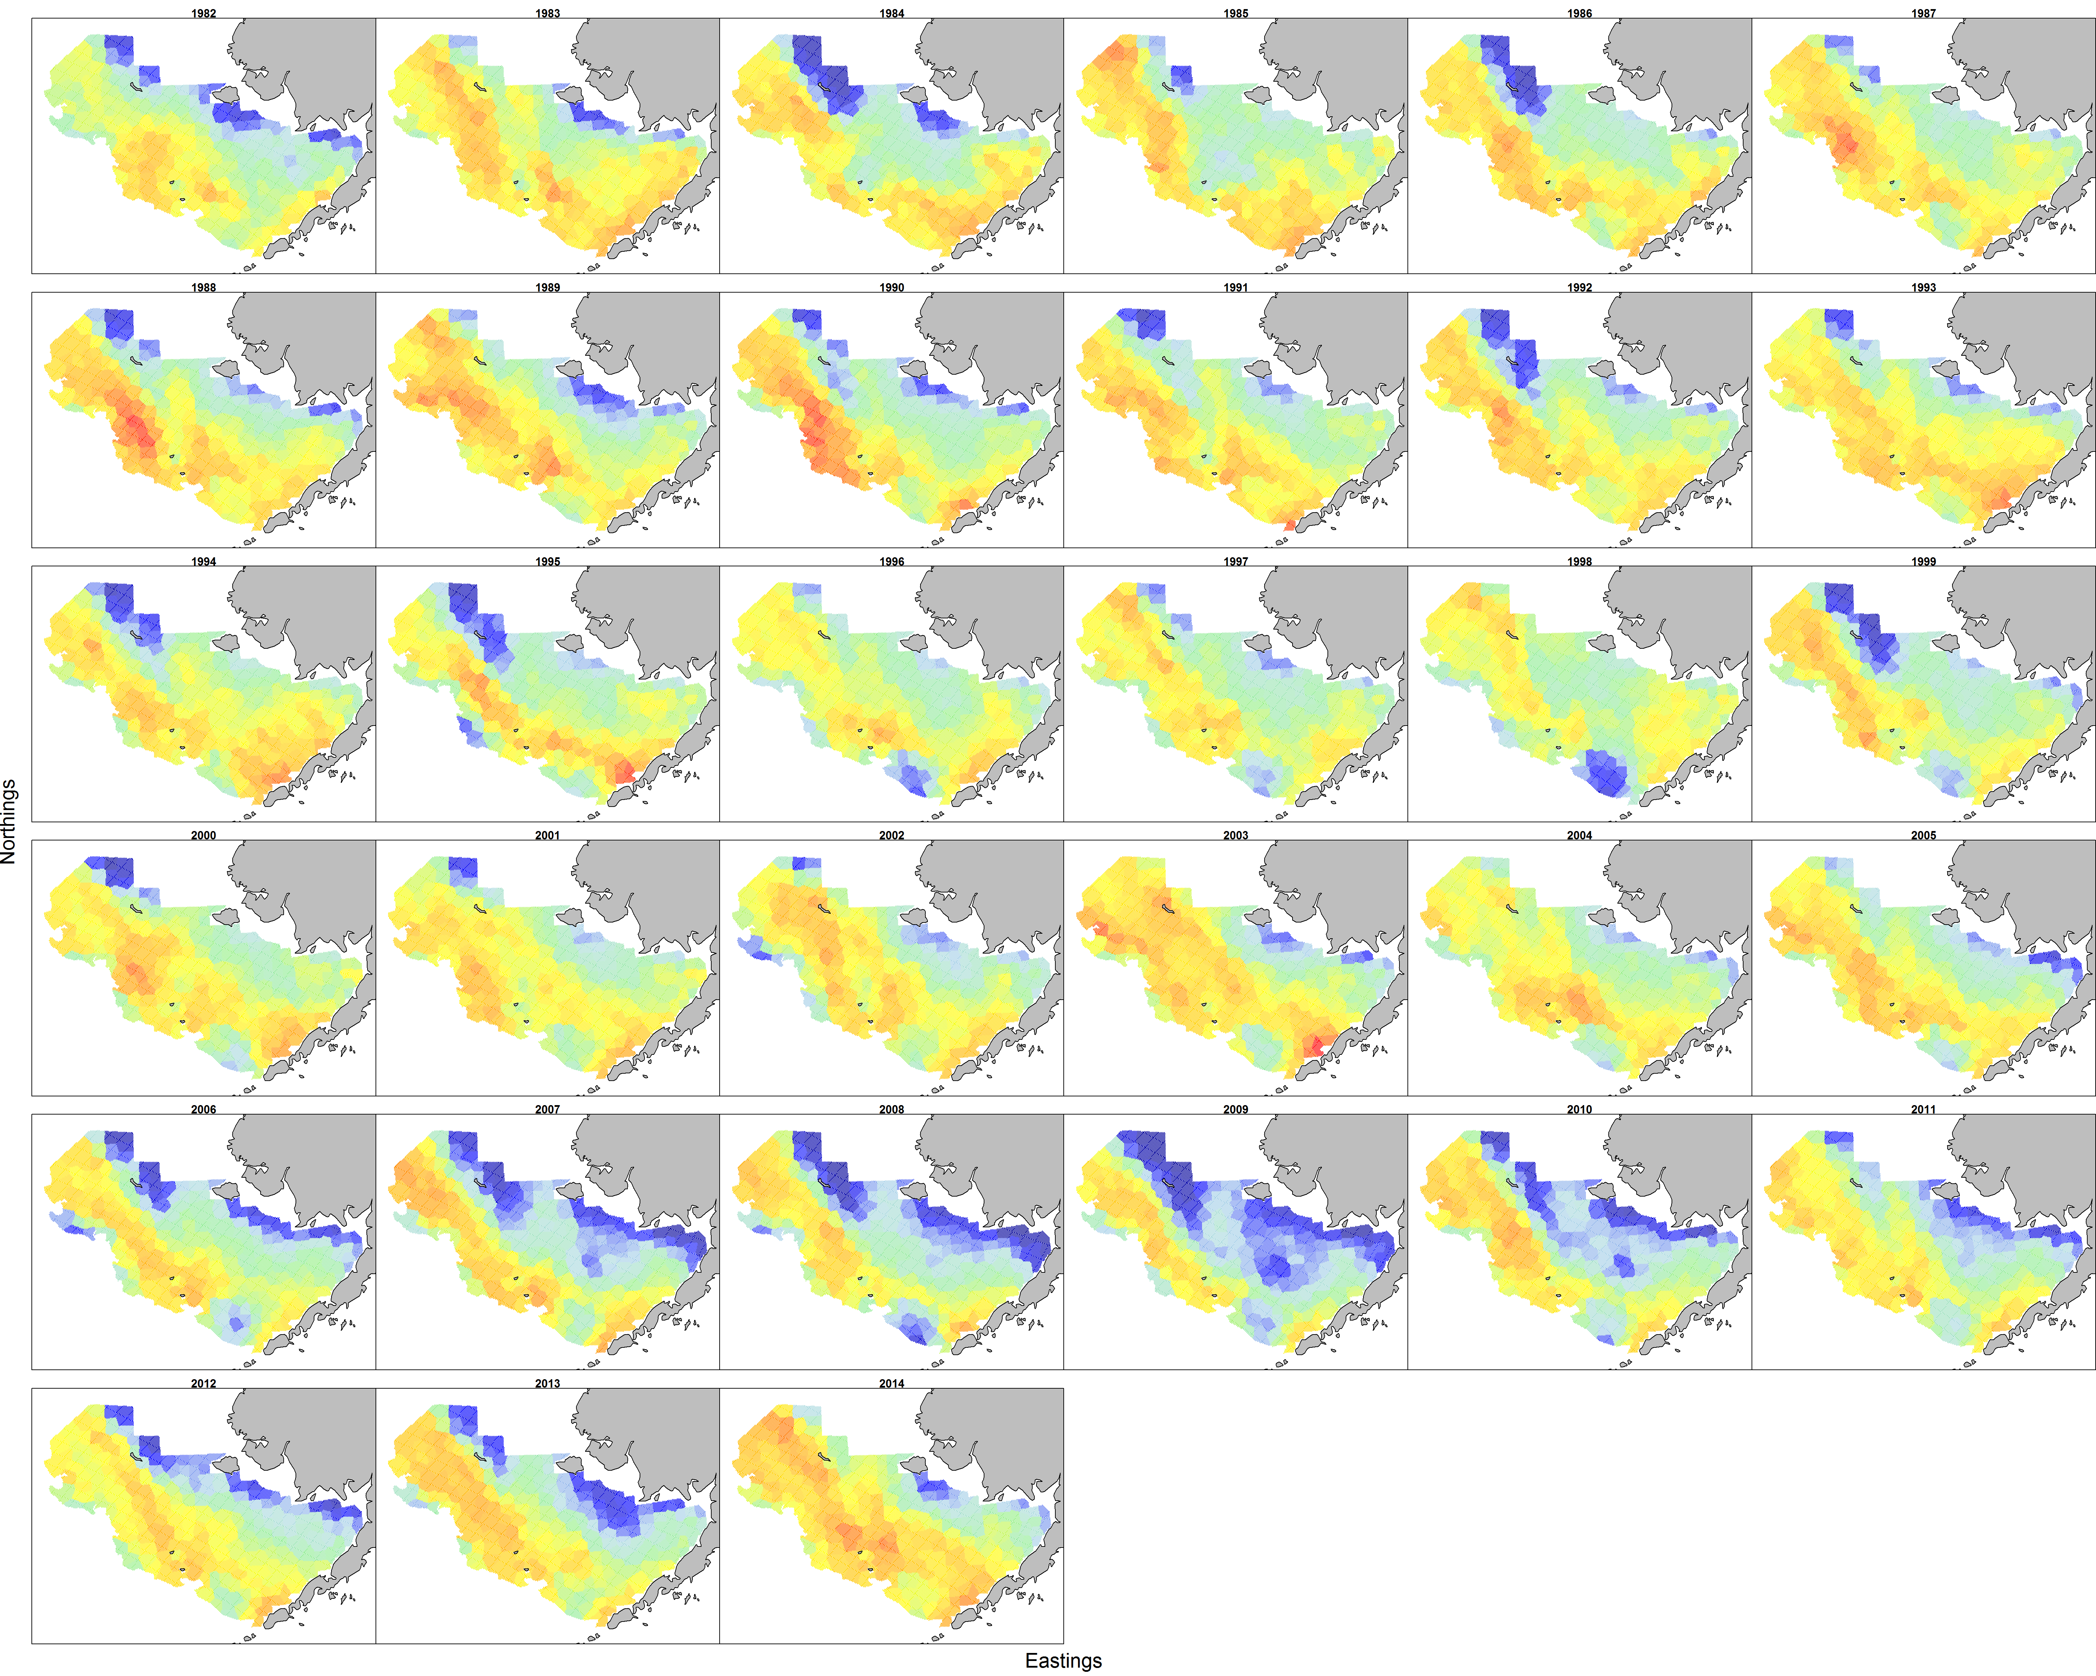
Two we will focus on:
Alaska pollock in the Eastern Bering Sea
Notes:
Ability to show shifts in distribution (see blue blob in that middle ish spot)
You COULD get a better fitting model with a smoother over time (autocorrelated year). But, that will also shrink changes towards the mean, which is typically not modeled in an index. Those assume indepenedence between years. We are choosing a probably worse fitting model on purpose,. Sacrifice fit to the data to fit the second stage model.

Slide 8
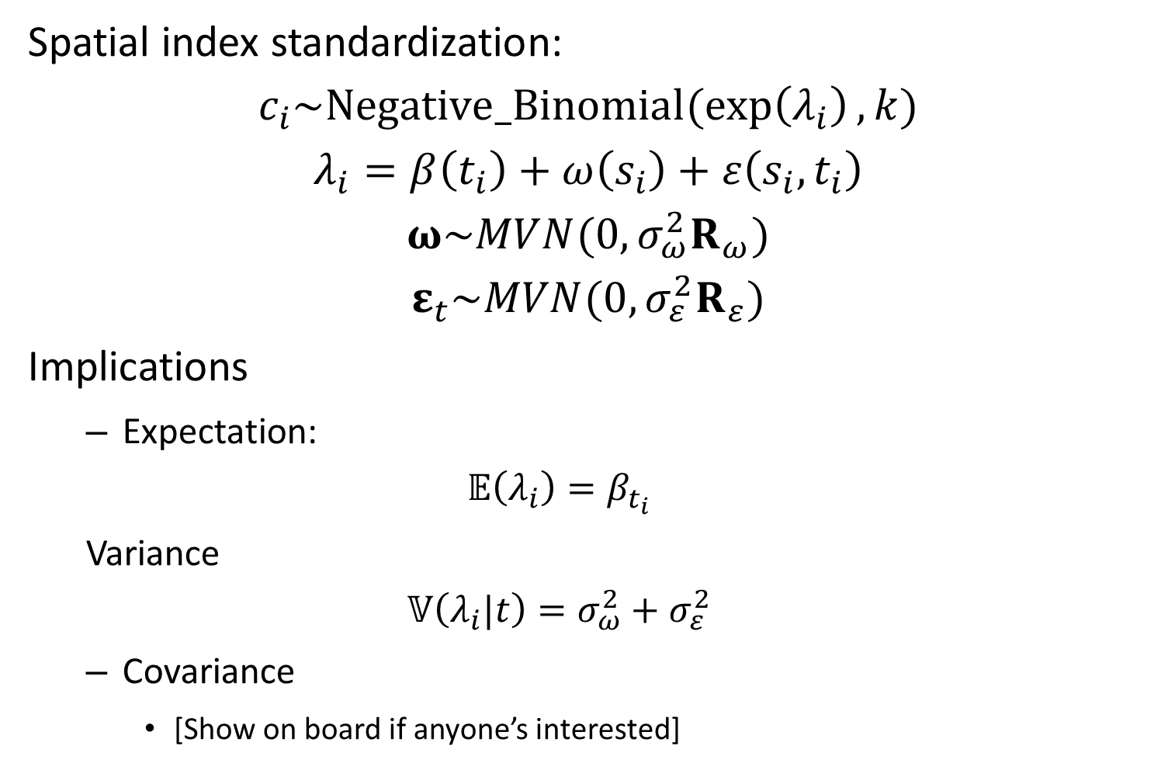
Spatial index standardization:
$$c_{i}\sim Negative_Binomial(\exp\left(λ_{i}\right),k)$$
$$λ_{i}=β\left(t_{i}\right)+ω\left(s_{i}\right)+ε\left(s_{i},t_{i}\right)$$
$$ω\sim MVN(0,σ_{ω}^{2}R_{ω})$$
$$ε_{t}\sim MVN(0,σ_{ε}^{2}R_{ε})$$
Implications
Expectation:
$$𝔼\left(λ_{i}\right)=β_{t_{i}}$$
Variance
$$𝕍\left(λ_{i}|t\right)=σ_{ω}^{2}+σ_{ε}^{2}$$
Covariance
[Show on board if anyone’s interested]
Notes:
Variance across space and time is sum of two variances
This version has slightly better estimation properties, but you can also parameterize it as a total covariance for both and then like a proportion for space

Slide 9
Ways to model survey data:
Discrete data
Counts
Often contains more zeros than expected (true and false zeros)
Continuous data
Biomass
Often arises from weighing all encountered individuals
Must model zeros (non-encounter) and positive real biomass

Slide 10
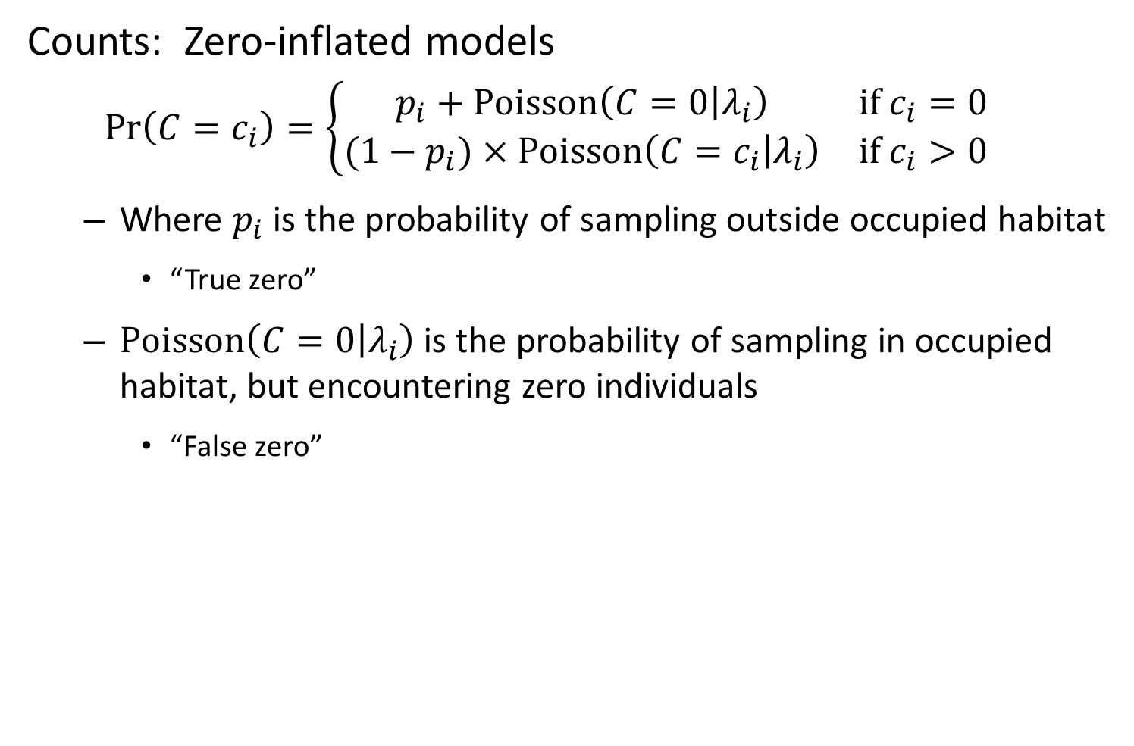
Counts: Zero-inflated models
$$\operatorname{Pr}\left(C=c_{i}\right)=\left\{\begin{matrix}p_{i}+Poisson\left(C=0 | λ_{i}\right) & if c_{i}=0 \\ (1−p_{i})×Poisson\left(C=c_{i} | λ_{i}\right) & if c_{i}>0\end{matrix}\right.$$
Where $p_{i}$ is the probability of sampling outside occupied habitat
“True zero”
$Poisson\left(C=0 | λ_{i}\right)$ is the probability of sampling in occupied habitat, but encountering zero individuals
“False zero”

Slide 11
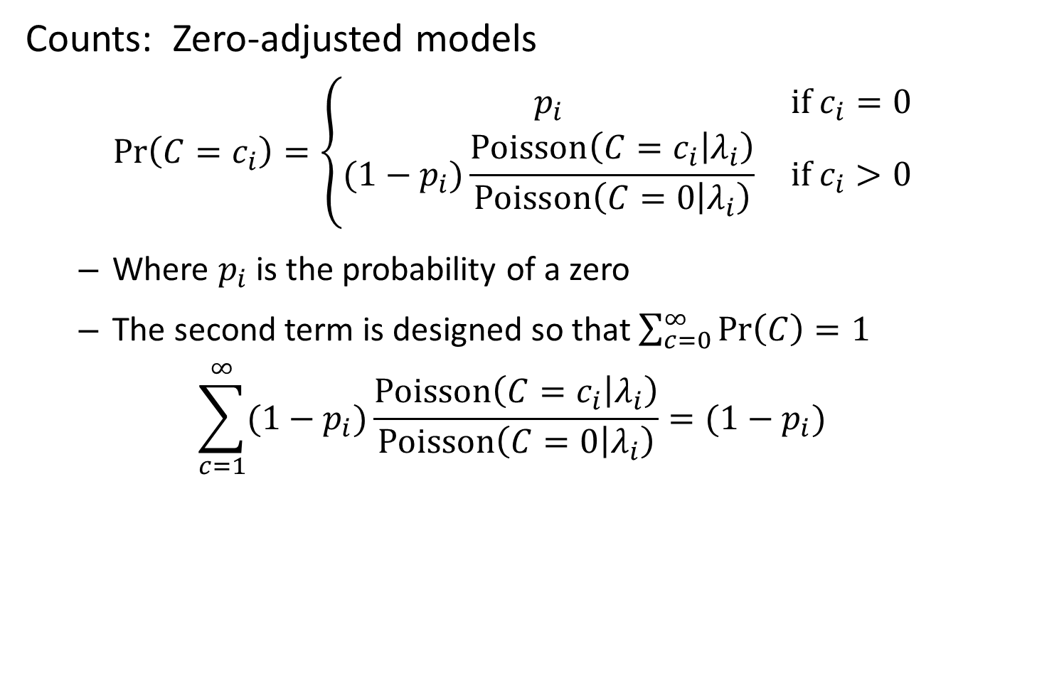
Counts: Zero-adjusted models
$$\operatorname{Pr}\left(C=c_{i}\right)=\left\{\begin{matrix}p_{i} & if c_{i}=0 \\ (1−p_{i})\frac{Poisson\left(C=c_{i} | λ_{i}\right)}{Poisson\left(C=0 | λ_{i}\right)} & if c_{i}>0\end{matrix}\right.$$
Where $p_{i}$ is the probability of a zero
The second term is designed so that $\sum_{c=0}^{∞}{\operatorname{Pr}\left(C\right)=1}$
$$\sum_{c=1}^{∞}{(1−p_{i})\frac{Poisson\left(C=c_{i} | λ_{i}\right)}{Poisson\left(C=0 | λ_{i}\right)}}=(1−p_{i})$$

Slide 12
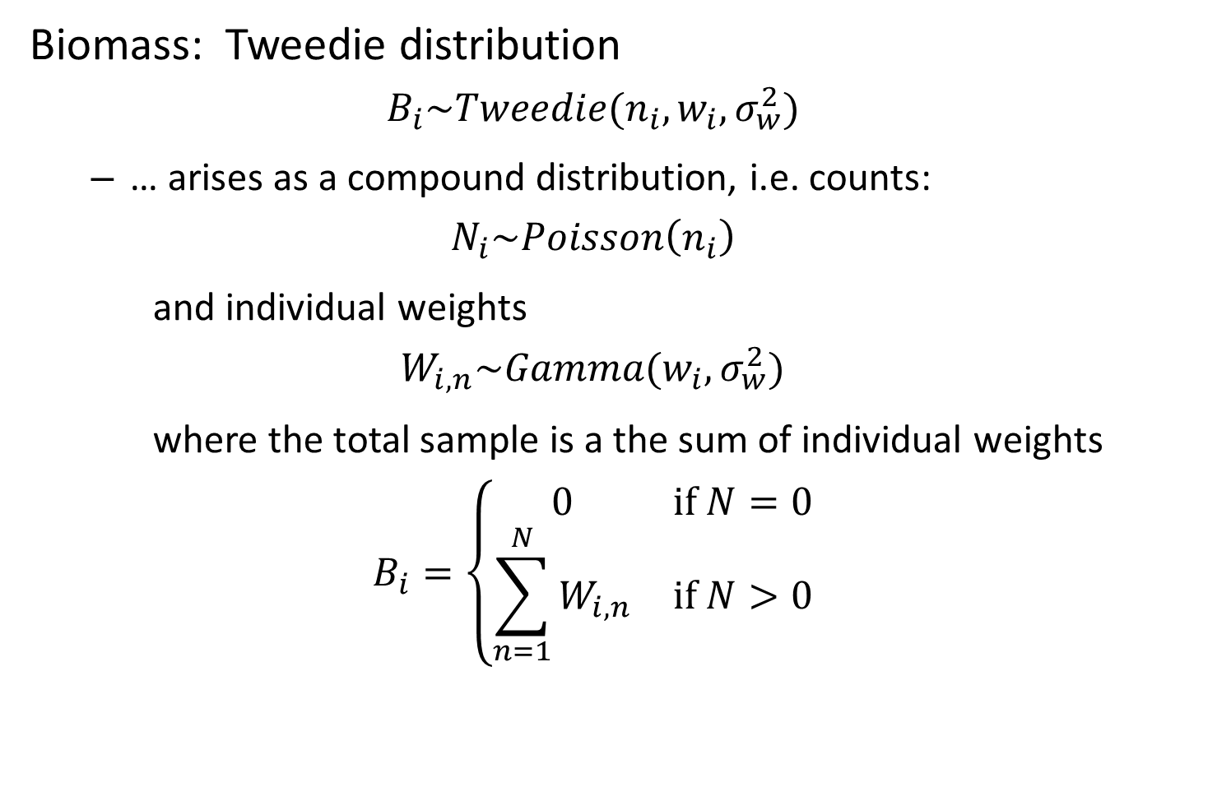
Biomass: Tweedie distribution
$$B_{i}\sim Tweedie(n_{i},w_{i},σ_{w}^{2})$$
… arises as a compound distribution, i.e. counts:
$$N_{i}\sim Poisson\left(n_{i}\right)$$
and individual weights
$$W_{i,n}\sim Gamma(w_{i},σ_{w}^{2})$$
where the total sample is a the sum of individual weights
$$B_{i}=\left\{\begin{matrix}0 & if N=0 \\ \sum_{n=1}^{N}{W_{i,n}} & if N>0\end{matrix}\right.$$

Slide 13
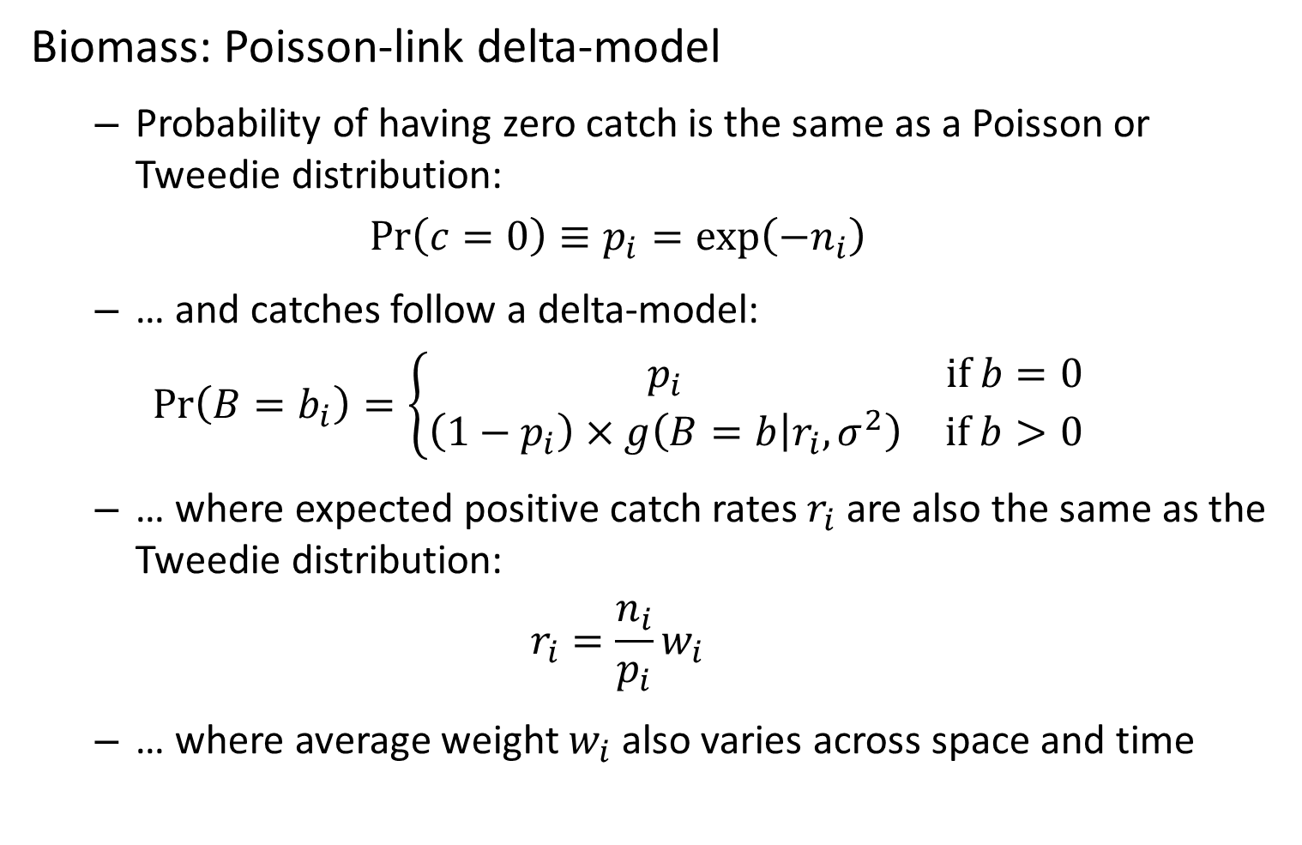
Biomass: Poisson-link delta-model
Probability of having zero catch is the same as a Poisson or Tweedie distribution:
$$\operatorname{Pr}\left(c=0\right)≡p_{i}=\exp\left(−n_{i}\right)$$
… and catches follow a delta-model:
$$\operatorname{Pr}\left(B=b_{i}\right)=\left\{\begin{matrix}p_{i} & if b=0 \\ \left(1−p_{i}\right)×g\left(B=b | r_{i},σ^{2}\right) & if b>0\end{matrix}\right.$$
… where expected positive catch rates $r_{i}$ are also the same as the Tweedie distribution:
$$r_{i}=\frac{n_{i}}{p_{i}}w_{i}$$
… where average weight $w_{i}$ also varies across space and time
Notes:
Jim advocating because faster than tweedie but has same first few moments
No weights? Probably won’t fit that well

Slide 14
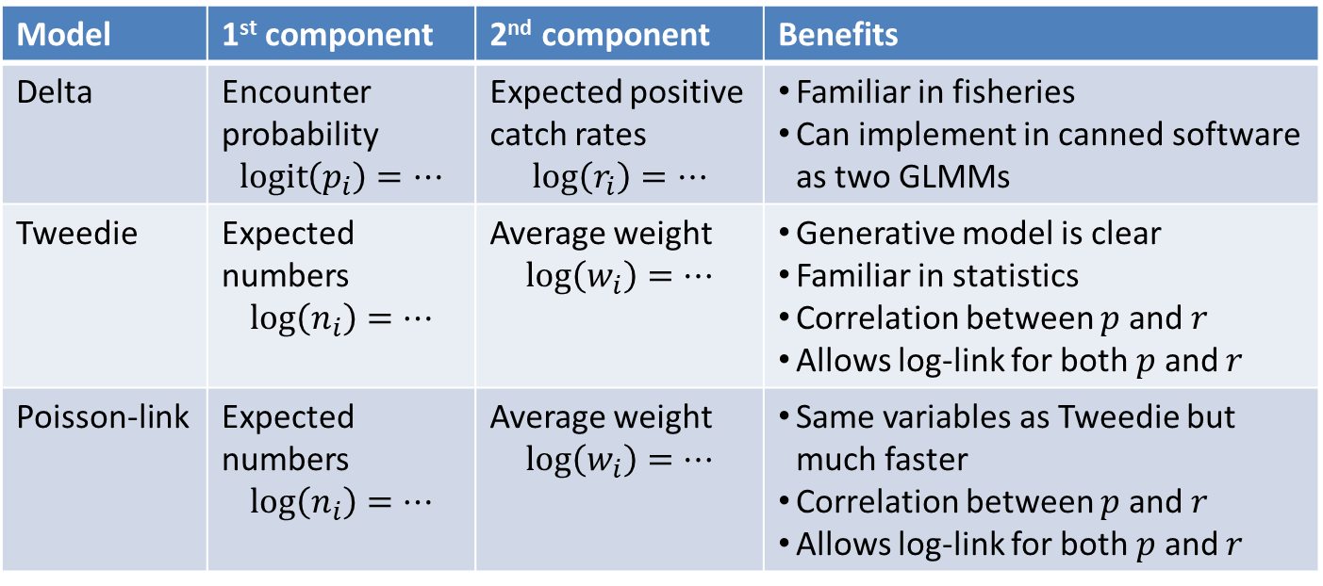
Biomass: Comparison of Tweedie, delta, and Poisson-link models
Model | 1st component | 2nd component | Benefits
Delta | Encounter probability $$\operatorname{logit}\left(p_{i}\right)=…$$ | Expected positive catch rates $$log\left(r_{i}\right)=…$$ | Familiar in fisheries Can implement in canned software as two GLMMs
Tweedie | Expected numbers $$\log\left(n_{i}\right)=…$$ | Average weight $$\log\left(w_{i}\right)=…$$ | Generative model is clear Familiar in statistics Correlation between $p$ and $r$ Allows log-link for both $p$ and $r$
Poisson-link | Expected numbers $$\log\left(n_{i}\right)=…$$ | Average weight $$\log\left(w_{i}\right)=…$$ | Same variables as Tweedie but much faster Correlation between $p$ and $r$ Allows log-link for both $p$ and $r$
Notes:
Correlation between p and r—macroecology theory says more abundant species will be more widely distributed
But Tweedie and all of it’s shortcuts are pretty expensive to evaluate computationally

Slide 15
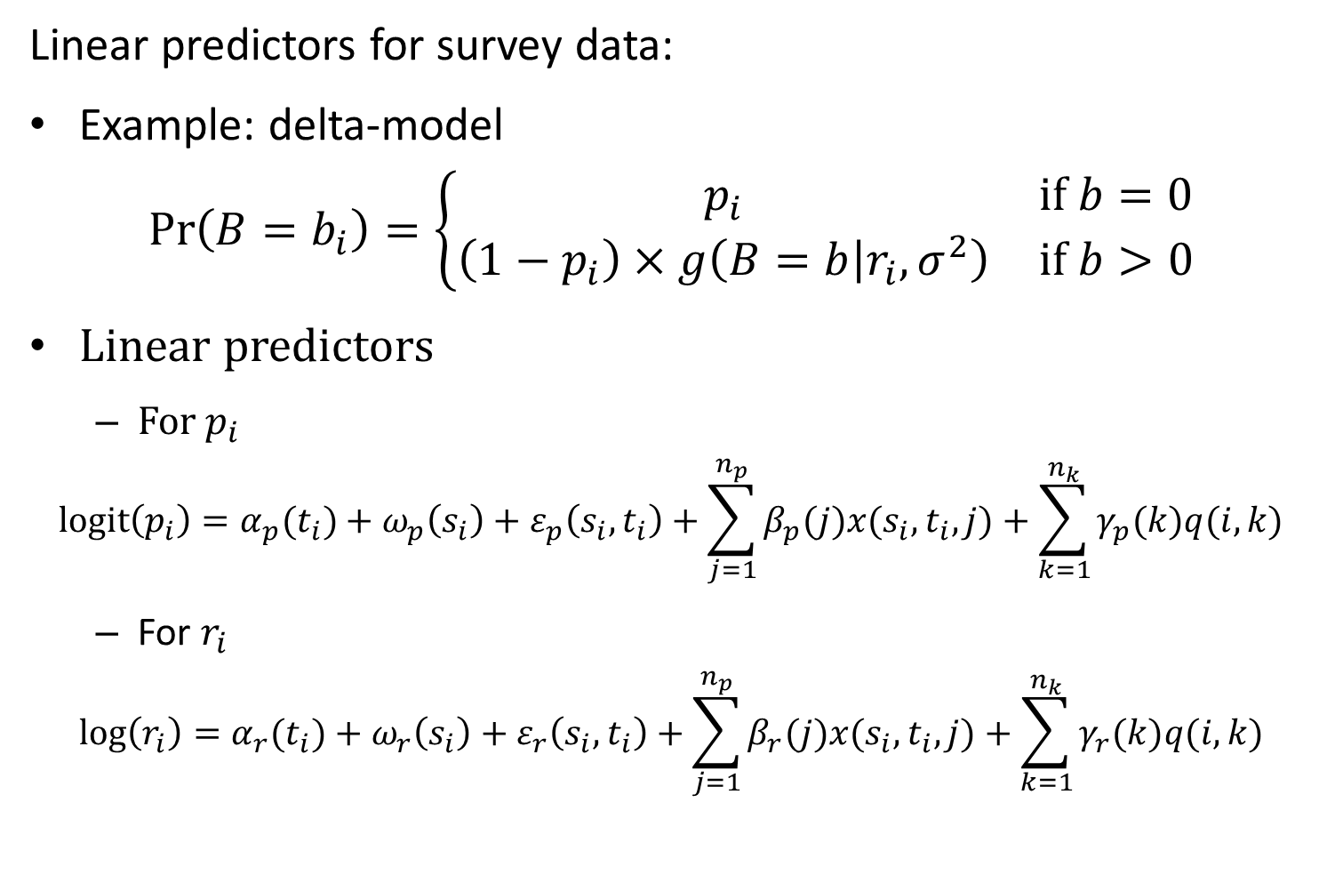
Linear predictors for survey data:
Example: delta-model
$$\operatorname{Pr}\left(B=b_{i}\right)=\left\{\begin{matrix}p_{i} & if b=0 \\ \left(1−p_{i}\right)×g\left(B=b | r_{i},σ^{2}\right) & if b>0\end{matrix}\right.$$
Linear predictors
For $p_{i}$
$$logit\left(p_{i}\right)=α_{p}(t_{i})+ω_{p}\left(s_{i}\right)+ε_{p}\left(s_{i},t_{i}\right)+\sum_{j=1}^{n_{p}}{β_{p}(j)x(s_{i},t_{i},j)}+\sum_{k=1}^{n_{k}}{γ_{p}(k)q(i,k)}$$
For $r_{i}$
$$log\left(r_{i}\right)=α_{r}(t_{i})+ω_{r}\left(s_{i}\right)+ε_{r}\left(s_{i},t_{i}\right)+\sum_{j=1}^{n_{p}}{β_{r}(j)x(s_{i},t_{i},j)}+\sum_{k=1}^{n_{k}}{γ_{r}(k)q(i,k)}$$
Notes:
R_i is expected positive catch rate
Linear predictor has similar structure to
Independent intercept, spatial effect, spatial temporal effect, x thing is a density covariate (e.g., corals associate with rocky habitat) and q is chatachability covariate (things that aren’t spatially referenced, like gear performance that doesn’t affect density. Including water state for bottom trawl, which reduces the catchability)
Use same parameters and structure in both predictors

Slide 16
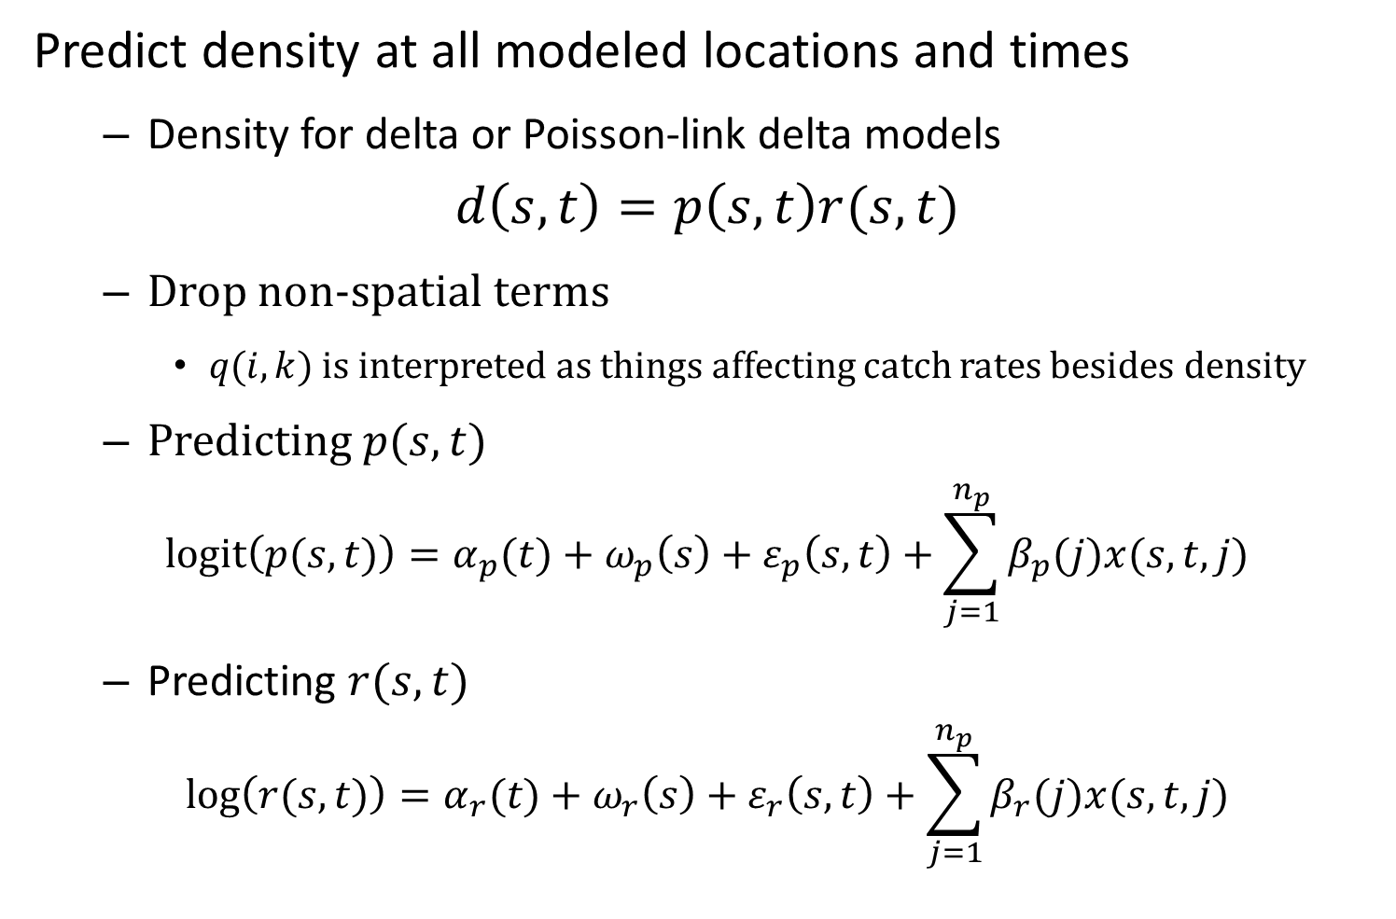
Predict density at all modeled locations and times
Density for delta or Poisson-link delta models
$$d\left(s,t\right)=p\left(s,t\right)r(s,t)$$
Drop non-spatial terms
$q(i,k)$ is interpreted as things affecting catch rates besides density
Predicting $p(s,t)$
$$logit\left(p(s,t)\right)=α_{p}(t)+ω_{p}\left(s\right)+ε_{p}\left(s,t\right)+\sum_{j=1}^{n_{p}}{β_{p}(j)x(s,t,j)}$$
Predicting $r(s,t)$
$$log\left(r(s,t)\right)=α_{r}(t)+ω_{r}\left(s\right)+ε_{r}\left(s,t\right)+\sum_{j=1}^{n_{p}}{β_{r}(j)x(s,t,j)}$$
Notes:
Predict after dropping the filtered out stuff

Slide 17
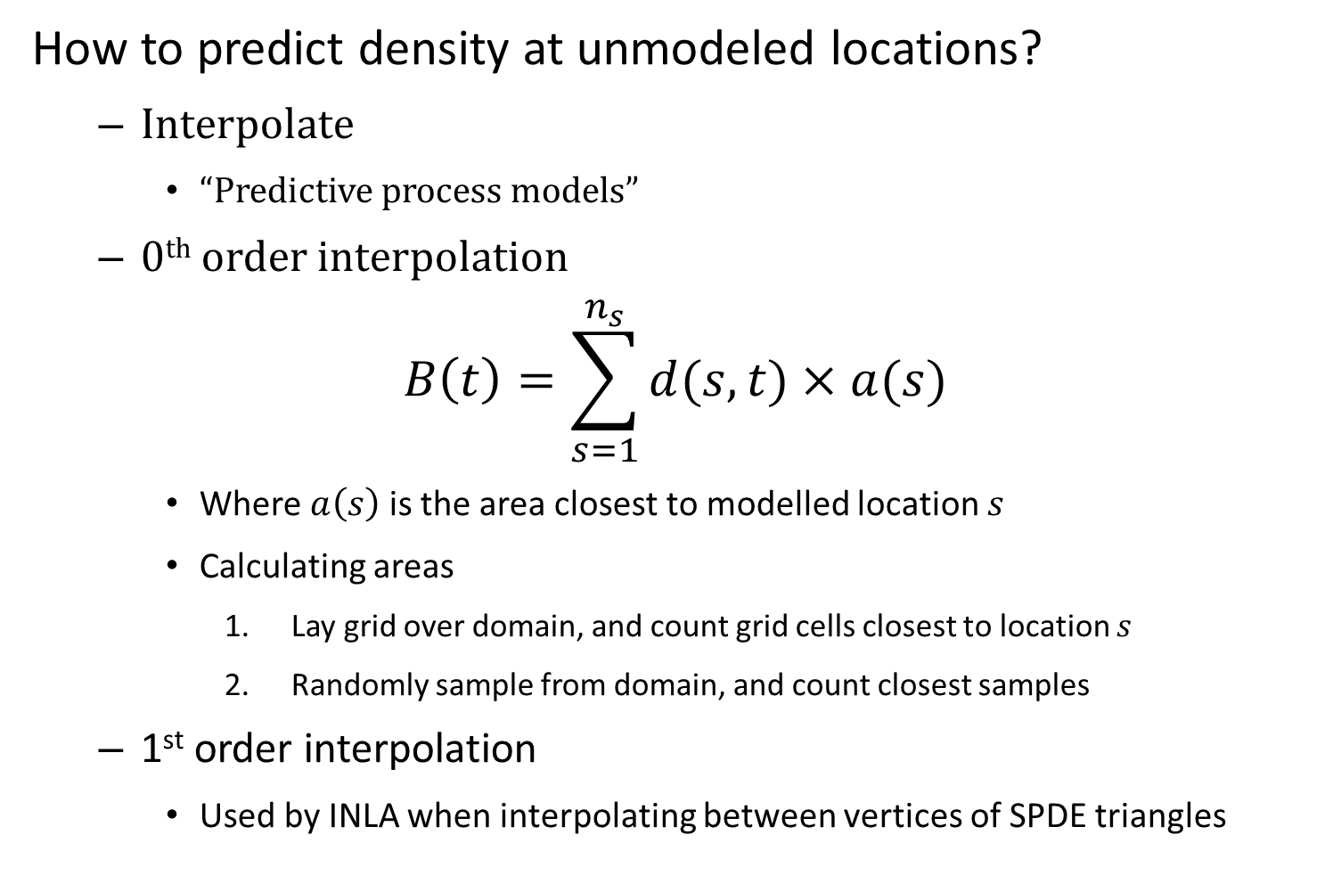
How to predict density at unmodeled locations?
Interpolate
“Predictive process models”
0th order interpolation
$$B\left(t\right)=\sum_{s=1}^{n_{s}}{d(s,t)×a(s)}$$
Where $a\left(s\right)$ is the area closest to modelled location $s$
Calculating areas
Lay grid over domain, and count grid cells closest to location $s$
Randomly sample from domain, and count closest samples
1st order interpolation
Used by INLA when interpolating between vertices of SPDE triangles
Notes:
Piecewise constant function, so at a certain grain size, the model assumes the things are constant (it’s the values at knots)
Higher order possible, but computationally expensive and Jim doesn’t think the models do that well at fine scales anyways

Slide 18
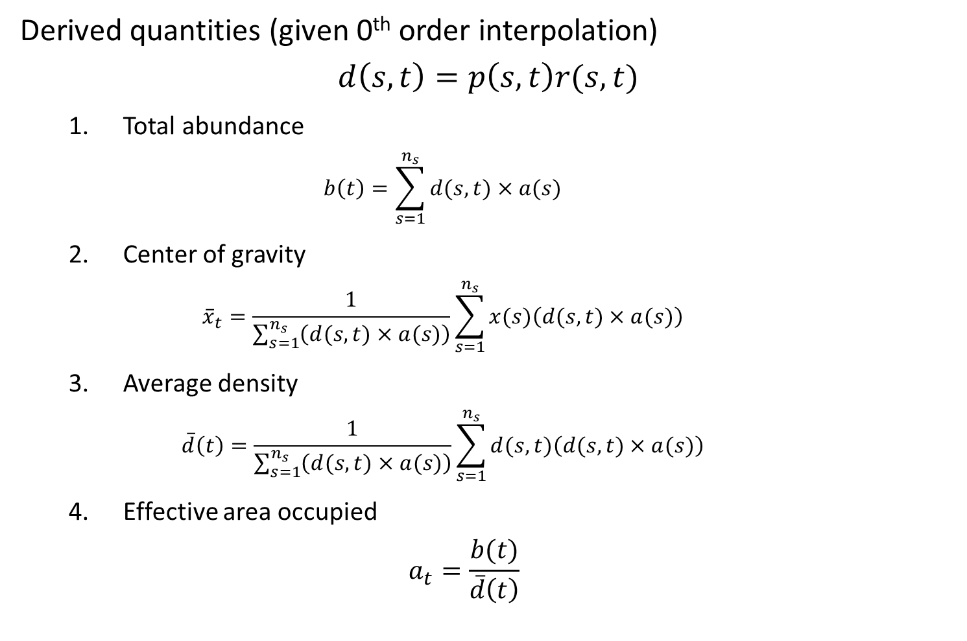
Derived quantities (given 0th order interpolation)
$$d\left(s,t\right)=p\left(s,t\right)r(s,t)$$
Total abundance
$$b\left(t\right)=\sum_{s=1}^{n_{s}}{d(s,t)×a(s)}$$
Center of gravity
$${\overline{x}}_{t}=\frac{1}{\sum_{s=1}^{n_{s}}{\left(d(s,t)×a(s)\right)}}\sum_{s=1}^{n_{s}}{x(s)\left(d(s,t)×a(s)\right)}$$
Average density
$$\overline{d}\left(t\right)=\frac{1}{\sum_{s=1}^{n_{s}}{\left(d(s,t)×a(s)\right)}}\sum_{s=1}^{n_{s}}{d(s,t)\left(d(s,t)×a(s)\right)}$$
Effective area occupied
$$a_{t}=\frac{b(t)}{\overline{d}\left(t\right)}$$
Notes:
Things we can predict from density function!
1. Total abundance—area weighted sum (integral across space) assuming predictive process is constant in the vicinity of your prediction point
3. Average biomass around every individual (measure of intraspecific competition)
4. Look at dimensional analysis—can get at area contraction or expansion, maybe into sub-optimal habitats

Slide 19
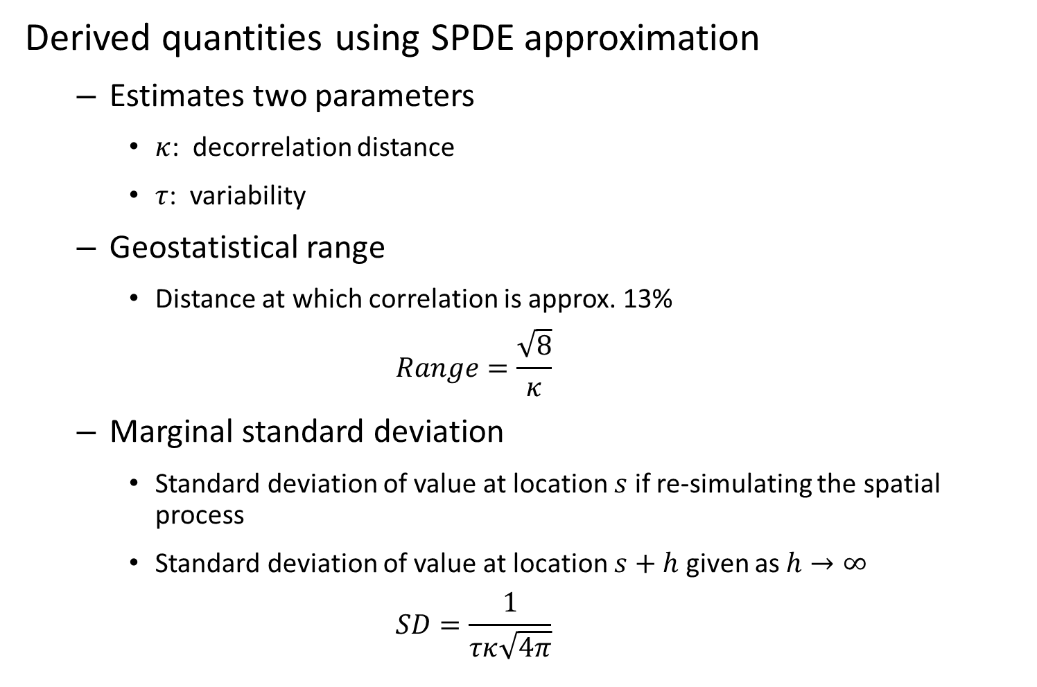
Derived quantities using SPDE approximation
Estimates two parameters
$κ$: decorrelation distance
$τ$: variability
Geostatistical range
Distance at which correlation is approx. 13%
$$Range=\frac{\sqrt{8}}{κ}$$
Marginal standard deviation
Standard deviation of value at location $s$ if re-simulating the spatial process
Standard deviation of value at location $s+h$ given as $h→∞$
$$SD=\frac{1}{τκ\sqrt{4π}}$$

Slide 20
Exercise
Divide into groups and add center-of-gravity, average density, and effective area occupied calculations

